Slide 1
Binary Tree (B)
Prepared by: Afaq Mansoor Khan
BSSE III- Group A
Session 2017-21
IMSciences, Peshawar.

Slide 2
Last Lecture Summary
Introduction to Binary Tree
Operations in Binary tree
Binary Search Tree
Insertion of New Node in BST
Deletion of a Node from BST
Notes:
A quick summary . . .

Slide 3
Objectives Overview
Recursive and Non Recursive Traversal of Binary/Binary Search Tree
In-Order Traversal
Pre-Order Traversal
Post-Order Traversal
Searching in a Binary Search Tree

Slide 4
Tree Traversals
A binary tree is defined recursively: it consists of a root, a left subtree, and a right subtree
To traverse the binary tree is to visit each node in the binary tree exactly once
Since a binary tree has three “parts,” there are six possible ways to traverse the binary tree:
root, left, right
left, root, right
left, right, root
root, right, left
right, root, left
right, left, root

Slide 5
Traversing the Tree
There are three simple ways to traverse a tree:
Inorder
Preorder
Postorder
Each of these methods is best implemented as a recursive function.

Slide 6
Inorder Traversing using Recursion
Inorder traversal will cause all the nodes to be visited in ascending order.
Steps involved in Inorder traversal (recursion) are:
-- Call itself to traverse the node’s left subtree
-- Visit the node (e.g. display a key)
-- Call itself to traverse the node’s right subtree.

Slide 7
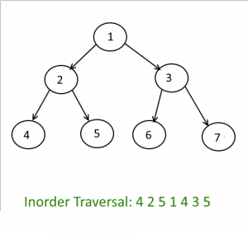
Inorder Traversing

Slide 8
Inorder Traversal
The node’s left subtree is traversed.
The node’s data is processed.
The node’s right subtree is traversed.

Slide 9
Inorder Traversing - Algorithm
Traverse the left subtree, i.e., call Inorder(left-subtree)
Visit the root.
Traverse the right subtree, i.e., call Inorder(right-subtree)

Slide 10
Inorder Traversing - Implementation
In inorder, the root is visited in the middle
Here’s an inorder traversal to print out all the elements in the binary tree:
public void inorderPrint(BinaryTree bt) { if (bt == null) return; inorderPrint(bt.leftChild); System.out.println(bt.value); inorderPrint(bt.rightChild); }

Slide 11
Non Recursive Inorder Traversing
Create an empty stack S.
Initialize current node as root
Push the current node to S and set current = current->left until current is NULL
If current is NULL and stack is not empty then:
Pop the top item from stack.
Print the popped item, set current = popped_item->right
Go to step 3.
If current is NULL and stack is empty then we are done.

Slide 12
Uses of Inorder
In case of binary search trees (BST), Inorder traversal gives nodes in non-decreasing order. To get nodes of BST in non-increasing order, a variation of Inorder traversal where Inorder traversals reversed can be used

Slide 13
Preorder Traversing using Recursion
Sequence of preorder traversal: e.g. use for infix parse tree to generate prefix
Steps involved in Preorder traversal (recursion) are:
-- Visit the node
-- Call itself to traverse the node’s left subtree
-- Call itself to traverse the node’s right subtree

Slide 14
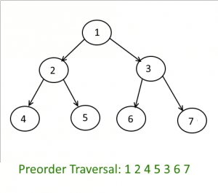
Preorder Traversing

Slide 15
Preorder Traversal
The node’s data is processed.
The node’s left subtree is traversed.
The node’s right subtree is traversed.

Slide 16
Preorder Traversing - Algorithm
Visit the root.
Traverse the left subtree, i.e., call Preorder(left-subtree)
Traverse the right subtree, i.e., call Preorder(right-subtree)

Slide 17
Preorder Traversing - Implementation
In preorder, the root is visited first
Here’s a preorder traversal to print out all the elements in the binary tree:
public void preorderPrint(BinaryTree bt) { if (bt == null) return; System.out.println(bt.value); preorderPrint(bt.leftChild); preorderPrint(bt.rightChild); }

Slide 18
Non Recursive Preorder Traversing
Create a Stack.
Print the root and push it to Stack and go left
i.e root=root.left and till it hits the NULL.
If root is null and Stack is empty then
return, we are done.
Else
Pop the top Node from the Stack and set it as, root = popped_Node.
Go right, root = root.right.
Go to step 2.
End If

Slide 19
Uses of Preorder
Preorder traversal is used to create a copy of the tree.
Preorder traversal is also used to get prefix expression on of an expression tree.

Slide 20
Postorder Traversing using Recursion
Sequence of postorder traversal: e.g. use for infix parse tree to generate postfix
Steps involved in Postorder traversal (recursion) are:
-- Call itself to traverse the node’s left subtree
-- Call itself to traverse the node’s right subtree
-- Visit the node.

Slide 21
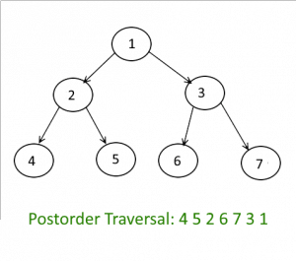
Postorder Traversing

Slide 22
Postorder Traversal
The node’s left subtree is traversed.
The node’s right subtree is traversed.
The node’s data is processed.

Slide 23
Postorder traversal - Algorithm
Traverse the left subtree, i.e., call Postorder(left-subtree)
Traverse the right subtree, i.e., call Postorder(right-subtree)
Visit the root.

Slide 24
Postorder traversal - Implementation
In postorder, the root is visited last
Here’s a postorder traversal to print out all the elements in the binary tree:
public void postorderPrint(BinaryTree bt) { if (bt == null) return; postorderPrint(bt.leftChild); postorderPrint(bt.rightChild); System.out.println(bt.value); }

Slide 25
Non Recursive Preorder Traversing
Push root into Stack_One.
while(Stack_One is not empty)
Pop the node from Stack_One and push it into Stack_Two.
Push the left and right child nodes of popped node into Stack_One.
End Loop
Pop out all the nodes from Stack_Two and print it.

Slide 26
Uses of Postorder
Postorder traversal is used to delete the tree.
Postorder traversal is also useful to get the postfix expression of an expression tree.

Slide 27
Searching the Tree - Algorithm
if the root is null:
the item is not in the tree; return null
Compare the value of target with root.data
if they are equal:
the target has been found; return the data at the root
else if the target is less than root.data:
return the result of searching the left subtree
else:
return the result of searching the right subtree

Slide 28
Searching the Tree
The IntBinaryTree class has a public member function, SearchNode, which returns true if a value is found in the tree, or false otherwise.
bool IntBinaryTree::searchNode(int num) { TreeNode *nodePtr = root; while (nodePtr) { if (nodePtr->value == num) return true; else if (num < nodePtr->value) nodePtr = nodePtr->left; else nodePtr = nodePtr->right; } return false; }

Slide 29
Example
// This program builds a binary tree with 5 nodes. // The SearchNode function determines if the // value 3 is in the tree. #include "IntBinaryTree.h“ void main(void) { IntBinaryTree tree; cout << "Inserting nodes.\n"; tree.insertNode(5); tree.insertNode(8); tree.insertNode(3); tree.insertNode(12); tree.insertNode(9);
if (tree.searchNode(3)) cout << "3 is found in the tree.\n"; else cout << "3 was not found in the tree.\n"; }
Program Output Inserting nodes. 3 is found in the tree.

Slide 30
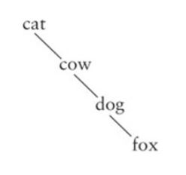
Searching Tree - Performance
Search a tree is generally O(log n)
If a tree is not very full, performance will be worse
Searching a tree with only right subtrees, for example, is O(n)

Slide 31
Summary
Recursive and Non Recursive Traversal of Binary/Binary Search Tree
In-Order Traversal
Pre-Order Traversal
Post-Order Traversal
Searching in a Binary Search Tree

Slide 32
References
https://www.geeksforgeeks.org/binary-tree-data-structure/
www2.latech.edu/~box/ds/chap8.ppt
https://www.slideshare.net/vanithachandru/binary-tree-24242122
https://www.cs.cmu.edu/~adamchik/15-121/lectures/Trees/trees.html
https://www.slideshare.net/almario1988/binary-tree-7787268

